Slide 1
topicEight
Multimedia Audio and Video

Slide 2
Learning Objectives
At the end of this chapter the students should be able to:
Save and upload music files to a web page.
Select appropriate background music for the web page.
Organize music into appropriate folder.
Selecting suitable file size to speed up downloading time

Slide 3
Introduction
One of the things that have made the Web so popular is the fact that you can add graphics, sound, animations, and movies to your Web pages.
While in the past the prohibitive size of such files limited their effectiveness, newer technologies, like streaming audio and video, along with broadband Internet connections have opened the door for multimedia Web pages

Slide 4
Plugins and Players
A browser application is only capable of showing text and a few kind of images.
But there are a lot of different kinds of files out on the Web, including video, audio, PDFs, Flash animations, Scorch sheet music, and even PowerPoint presentations and Excel spreadsheets.
In order to play or display these other kinds of files, a browser needs the aid of applications called players

Slide 5
Plugins and Players
There are both external stand-alone players that function as separate programs on your visitor's computer as well as plugin players that work right inside the Web page in the browser window.
You determine the kind of player that will be used when you write the HTML code.
When you link to a multimedia file, that file is opened in an external player

Slide 6
Plugins and Players
When you embed a multimedia file, the file is opened in the plugin within the browser window itself.
The most common plugins are the Flash and Shockwave players from Macromedia (part of Adobe), the QuickTime Player from Apple, the Windows Media Player from Microsoft, and Acrobat from Adobe.

Slide 7
Getting Multimedia Files
The most common multimedia files embedded on Web pages are sounds and videos.
You can create sounds with a microphone and digitizing software (like SoundRecorder for Windows and Amadeus for Macintosh).
And there are many programs that create MP3s from CDs.
With the advent of digital camcorders, getting video on the Web has gotten easier and easier

Slide 8
Getting Multimedia Files
On the Mac you have the unbeatable iMovie (preinstalled free on new Macs) which lets you input digital video via the incorporated FireWire port, add special effects and transitions, and then automatically convert it to QuickTime format which is easily embedded on a Web page.
Folks with Windows XP can use Windows Movie Maker.
You can also find sounds and movies on the Web, although you should read the corresponding license agreements carefully.

Slide 9
Getting Multimedia Files
You can also embed Flash animations (with Macromedia Flash), PDF files (created with Adobe Acrobat), playable sheet music (with Sibelius Scorch), Java applets (with Sun's Java), and much more

Slide 10
Linking to Multimedia Files
The easiest and fastest way to give your visitors access to multimedia files is by creating a link to the file.
Links have several advantages.
First, your visitor gets to choose whether to load a potentially large file or not.
Second, the file will open in any compatible player the visitor has available, not just the one you chose, making it more likely the visitor won't have to download any special software.

Slide 11
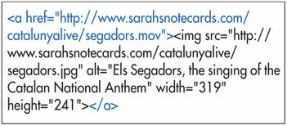

Slide 12
To link to multimedia files:
Create a multimedia file and upload it to your server.
Type <a href="multimedia.ext">, where multimedia.ext is the location, name, and extension of the multimedia file.
Type the text or insert an image that the visitor will click on to activate the link.
Type </a> to complete the link.

Slide 13
Embedding QuickTime Movies for Windows
Create a movie and save it in QuickTime format with the .mov extension.
In your Web page, where you want the movie to appear, begin the object element for IE for Windows by typing <object classid="clsid:02bf25d5-8c17-4b23-bc80-d3488abddc6b" codebase="http://www.apple.com/qtactivex/qtplugin.cab".
Next, without closing the initial object tag yet, type width="w" height="h", where w and h are the desired width and height, in pixels, of the box that will hold the movie.
Type > to complete the initial object tag.
Next, type <param name="src" value="filename.mov">, where filename.mov is the URL of your movie file.
Type <param name="autoplay" value="false">, to keep the movie from starting automatically when the visitor jumps to this page
If you want control buttons to appear under the movie, type <param name="controller" value="true". Or use a value of false to hide the controls.
Insert more parameters as desired
Complete the object element by typing </object>.

Slide 14
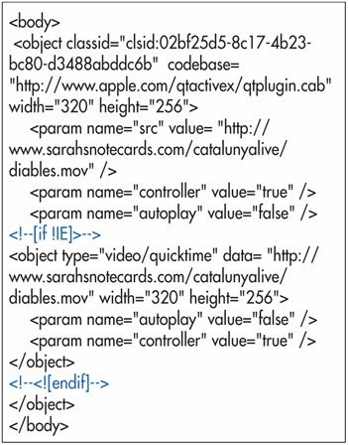

Slide 15
Scaling a QuickTime Movie
To scale a QuickTime movie:
Within each object element, type <param name="scale" value="factor" />, where factor is:
tofit, if you want the movie to be reduced or expanded to fit its box.
Or aspect, if you want the movie to be reduced or expanded to fit its box while maintaining its original proportions.
Or n, where n is the number with which the original height and width of the movie will be multiplied to get the final height and width

Slide 16
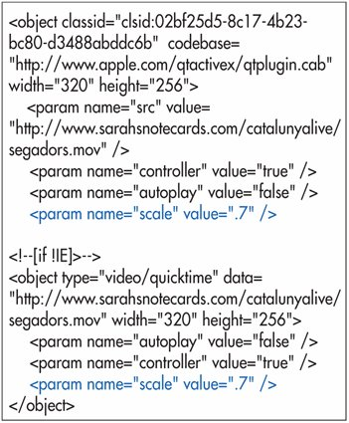

Slide 17
Looping a QuickTime Movie
To loop a QuickTime movie:
Within each object element, type <param name="loop" value="option">, where option is true if you want the movie to loop continuously, false if you want the movie to play just once and palindrome if you want the movie to play forwards and then backwards, continuously

Slide 18
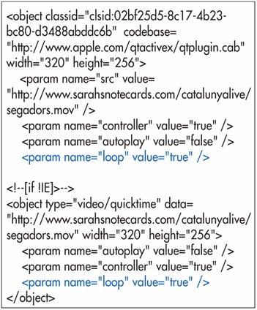

Slide 19
Embedding MP3 Audio on a Page
To embed MP3 audio on a page:
Save your audio tracks in MP3 format. You can use iTunes to convert AIFF files to MP3
Follow the instructions for putting regular QuickTime movies on a page (see pages 286293) using audio/mpeg for the type attribute in the second object
Use a value of 16 for the height of your controller.
For the width, use: a value of 17 for just a play button

Slide 20
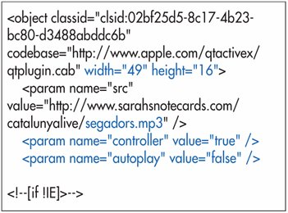

Slide 21
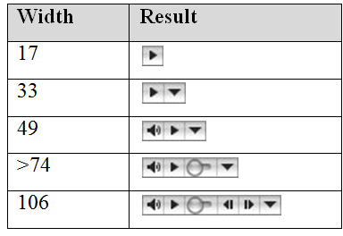

Slide 22
Embedding Windows Media Player Files
To embed Windows Media Player files:
Create the desired movie or sound.
In your HTML document, type <object classid="clsid:6bf52a52-394a-11d3-b153-00c04f79faa6" id="player".
Next type width="w" height="h", where w and h are the size in pixels of the media player that you'd like to embed.
Type > to complete the initial object tag.
To tell the player where the media file is, type <param name="url" value="movie.wmv">, where movie.wmv is the name and extension of the movie file.
If desired, you can type <param name="autostart" value="false"> in order to keep the file from playing automatically. The default is True.
If desired, you can type <param name="showcontrols" value="false"> to hide the play, rewind and other control buttons. The default value is true.
For browsers besides Internet Explorer, type <embed type="application/xmplayer2" id="MediaPlayer" to tell them what to expect.
Next type src="http://www.movie.wmv", where movie.wmv is the location, name, and extension of the movie file.
Type width="w" height="h">, where w and h are the dimensions in pixels of your movie file.
If you want the movie to start playing automatically, type autostart="true".
If you want to hide the control buttons, type showcontrols="false".
Type /> to complete the embed element.

Slide 23
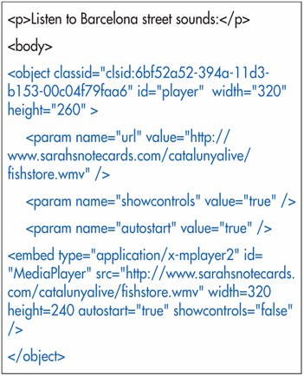

Slide 24
Music
There are many computer formats for sound, and theoretically any of them could be used in a web page.
The three most popular formats (those most likely to work on your readers' machines) are WAVE, AU, and MIDI.

Slide 25
Music
WAVE (Waveform Audio File Format, with the file extension .wav) was invented for Windows by Microsoft.
AU (Audio File Format, file extension .au) was invented by NeXT and Sun.
Both are now widely accepted on many platforms, and are common on web pages.
WAVE and AU are like sound recordings.
They reproduce recorded sounds (or computer generated sounds).
They also tend to be big files for just a little sound

Slide 26
Music
WAVE and AU files are good for a short sound effect such as a short greeting or perhaps a cow moo.
MIDI (Musical Instrument Digital Interface) is an entirely different concept.
The MIDI file format is a series of commands such as "play middle C for .25 seconds".
These sort of commands are very small, so one of the great advantages of MIDI files for your web page is that a lot of music can be packed in a small MIDI file.

Slide 27
Music
The downside of MIDI is that it takes a real master to work any expressiveness into this electronic command-based format.
MIDI music tends to have an uninteresting "easy listening" quality to it, making your web page seem like a dentist office

Slide 28
Inserting music
There are 2 ways of inserting background sound:
Embed.
Bgsound.

Slide 29
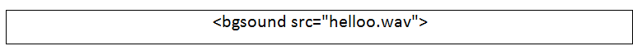
Bgsound
Attributes
SRC
SRC gives the location of the sound to play.
Loop
How many times to loop the background sound. LOOP can either have a finite value (1,2,3 or some other number) or INFINITE which tells the browser to play the sound over and over forever.
<bgsound src="helloo.wav" loop="5">
<bgsound src="helloo.wav" loop="infinite">

Slide 30
Embed
<embed ...> puts a browser plugin in the page. a plugin is a special program located on the client computer that handles its own special type of data file.
The most common plugins are for sounds and movies. the <embed ...> tag gives the location of a data file that the plugin should handle.
In its simplest use, <embed ...> uses the src attribute to indicate the location of the plugin data file, and usually also gives a width and height of the plugin area

Slide 31
Attribute | Function
src | url of resource to be embedded.
width | Width of area in which to show resource.
height | Height of area in which to show resource.
align | How text should flow around the picture.
name | Name of the embedded object.
pluginspage | Where to get the plugin software.
pluginurl | Where to get the jar archive for automatic installation.
hidden | If the object is visible or not.
href | Make this object a link.
target | Frame to link to.
autostart | If the sound/movie should start automatically.
loop | How many times to play the sound/movie.
playcount | How many times to play the sound/movie.
volume | How loud to play the sound.
controls | Which sound control to display.
controller | If controls should be displayed.
mastersound | Indicates the object in a sound group with the sound to use.
starttime | How far into the sound to start and stop.
endtime | When to finish playing.

Slide 32
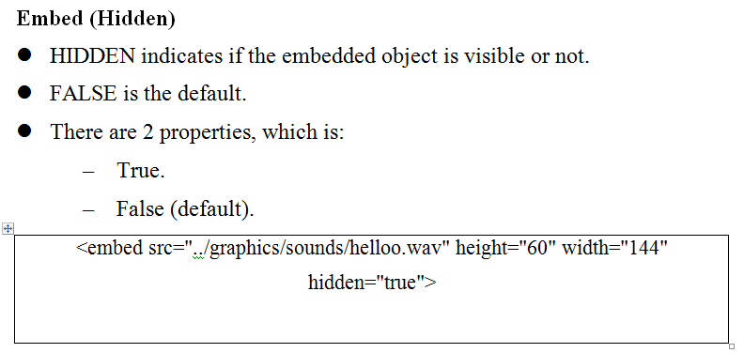
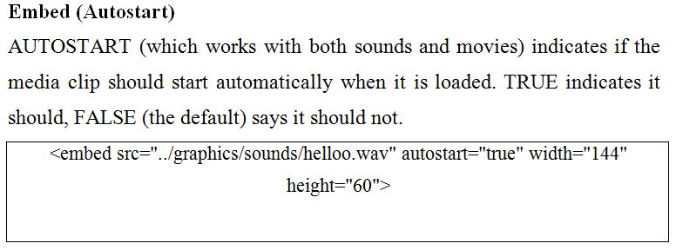

Slide 33
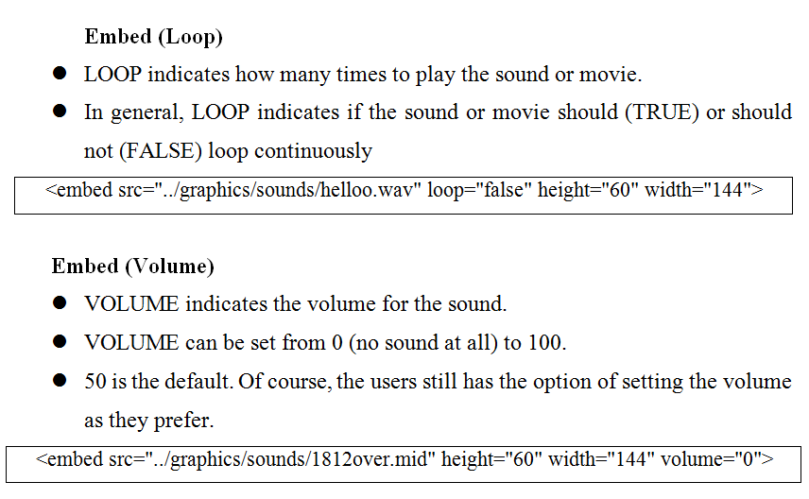

Slide 34
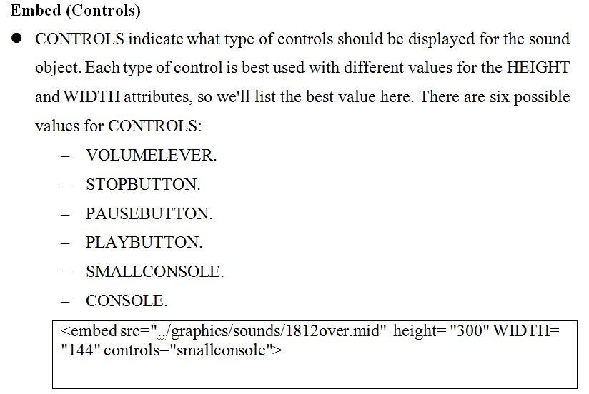

Slide 35
Inserting Java Applets
Java applets are little applications (hence the term applets) that can run in your browser to create special effects on your page, like clocks, calculators, and interactive events

Slide 36
To insert an applet:
Type <object codetype="application/ java" classid="java:file.class", where file.class is the name of the applet you want to embed.
Then type width="w" height="h", where w and h are the applet's size in pixels.
Close the opening object tag with >.
Include any parameters, with <param name="parameter" value="value_of_parameter" />.
Finally, type </object> to finish

Slide 37
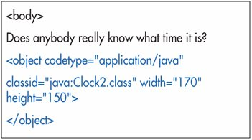
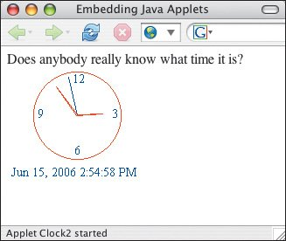

Slide 38
Embedding Other Multimedia Files
Other common types of multimedia files that you might want to embed on a page include Flash animations, Acrobat PDFs, Real audio and video, Scorch sheet music, and more.
To embed other multimedia files:
Go to the Web site of the company that develops the player for the multimedia files you want to embed. For example, for Scorch, go to Sibelius' site (http://www.sibelius.com).
Look for developer information on the Web site or search for "embed". Most plugin developers provide information on their use

Slide 39
Creating an Automatic Slide Show
You can use a special feature of the meta attribute, within the head section, to automatically move the reader from one page to another.
If you set up a series of pages in this way, you create a Web slide show

Slide 40
To create an automatic slide show:
In the first page, within the head section, type <meta http-equiv="refresh".
Type content="n; where n is the number of seconds the current page should display on the screen.
Type url=nextpage.html" /> where next-page.html is the URL of the next page that you want the visitor to jump to automatically.
Repeat these steps for each page in the series.

Slide 41
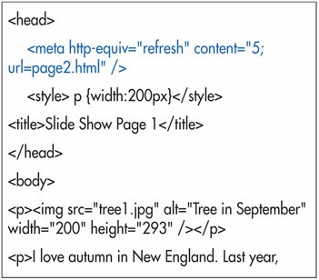

Slide 42
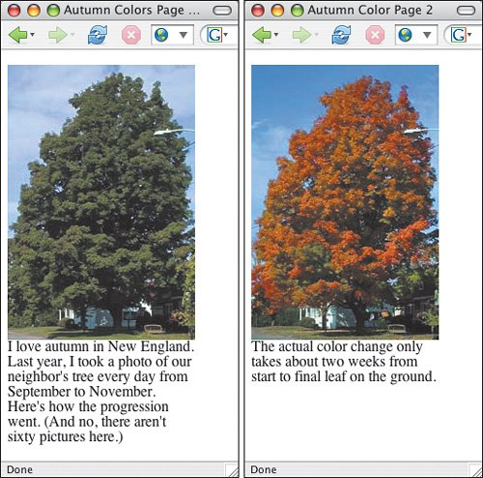

Slide 43
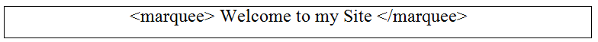
Marquee
Marquee creates a scrolling display and it is a MSIE extension, but is now supported by NS 7.
Marquee is often regarded as one of the "evil" tags, and that perception alone might be enough reason to not use it.
However, used lightly and with taste and understanding that it will never render everywhere.
Marquee isn't such a bad tag. It can work well for announcements.
The basic use of marquee is simple.
Put most any kind of markup between:

Slide 44
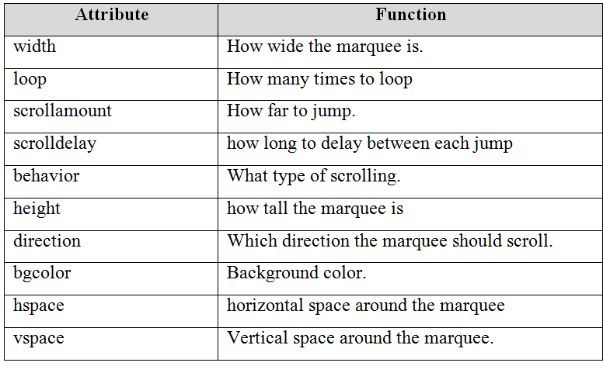

Slide 45
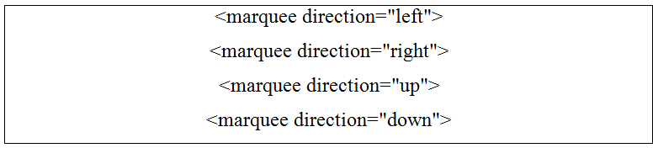
Attributes (Direction)
Direction indicates which direction the marquee scrolls. direction=left, which is the default, indicates that the marquee starts at the right and moves leftwards across the page. direction=right indicates that the marquee starts at the left and moves rightwards across the page.

Slide 46
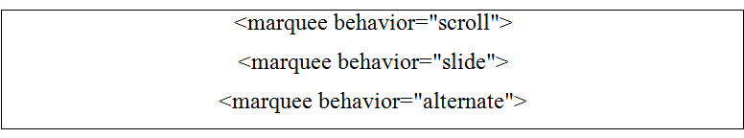
Attributes (Behavior)
BEHAVIOR indicates how the contents scroll. BEHAVIOR=SCROLL, which is the default, indicates that the content should scroll off the edge of the marquee area, and then reappear on the other side.
BEHAVIOR=SLIDE is almost the same, except that it indicates that when the leading part content reaches the left edge it should stop without scrolling off.
BEHAVIOR=ALTERNATE makes the content bounce back and forth, all of it remaining visible all the time (assuming of course that it all fits).

Slide 47
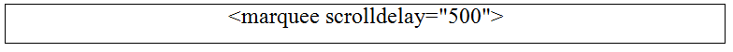
Attributes (Scrolldelay)
SCROLLDELAY, together with SCROLLAMOUNT, sets the speed of the scrolling.
Marquee moves the content by displaying the content, then delaying for some short period of time, then displaying the content again in a new position.
SCROLLDELAY sets the amount of delay in milliseconds (a millisecond is 1/1000th of a second).
The default delay is 85.

Slide 48
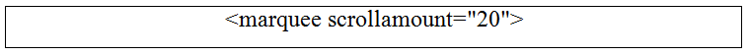
Attributes (Scrollamount)
SCROLLAMOUNT, together with SCROLLDELAY, sets the speed of the scrolling.
Marquee moves the content by displaying the content, then delaying for some short period of time, then displaying the content again in a new position.
SCROLLAMOUNT sets the size in pixels of each jump.
A higher value for SCROLLAMOUNT makes the marquee scroll faster.
The default value is 6.

Slide 49
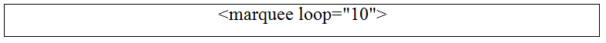
Attributes (Loop)
LOOP sets how many times the marquee should loop.
The default value (i.e. if you don't put a LOOP attribute at all) is INFINITE, which means that the marquee loops endlessly.

Slide 50
